Slide 1
Web Application Security
By : GE GDC Compliance Team

Slide 2
Table of contents
What is Web Application Security
Web Application Vulnerability or Risk
Web Application security testing methodologies : SAST vs DAST
Common Web application security vulnerabilities.
Cross Site Scripting ( XSS )
SQL Injection
Information Leakage or Information Disclosure
Broken Authentication and Session Management
Security Misconfiguration
Cross site request forgery
Components with known vulnerabilities
Broken Access Control
Hardening the HTTP Response headers

Slide 3
What is Web Application Security
Web application security is a branch of information security that deals specifically with security of websites, web applications and web services.
Web application security is the process of securing confidential data stored online from unauthorized access and modification. This is accomplished by enforcing stringent policy measures.
Web application security aims to address and fulfill the four conditions of security, also referred to as principles of security:
Confidentiality: States that the sensitive data stored in the Web application should not be exposed under any circumstances.
Integrity: States that the data contained in the Web application is consistent and is not modified by an unauthorized user.
Availability: States that the Web application should be accessible to the genuine user within a specified period of time depending on the request.
Nonrepudiation: States that the genuine user cannot deny modifying the data contained in the Web application and that the Web application can prove its identity to the genuine user.

Slide 4
Web Application Vulnerability or Risk
Application Vulnerability – System flaws or weakness in an application that could be exploited or compromise the security of the application.
Attackers can potentially use many different paths through the application to do harm to the business or organization. Each of these paths represents a risk that may, or may not, be serious enough to warrant attention.
75% of attacks today happen at the Application Layer (Gartner).
Many “easy hacking recipes” published on web.
Security holes in the web application layer can make a perfectly patched and firewalled server completely vulnerable.
“ The cost and reputation savings of avoiding a security breach are PRICELESS “
The Open Web Application Security Project (OWASP) is a non-profit organization dedicated to providing unbiased, practical information about application security.
The OWASP Top 10 Web Application Security Risks provides guidance to developers and security professionals on the most critical vulnerabilities that are commonly found in web applications, which are also easy to exploit.

Slide 5
Web Application security testing methodologies : SAST vs DAST
Application security encompasses measures taken to improve the security of an application often by finding, fixing and preventing security vulnerabilities.
Different techniques are used to surface such security vulnerabilities at different stages of an applications lifecycle such as design, development, deployment, upgrade, maintenance.
Static Application Security Testing (SAST) :
SAST consists of internal audit of an application, when security auditor or tool has unlimited access to the application source code or binary. SAST - is a source code review that can be performed both manually and automatically. One of the biggest advantages of SAST is that it can detect the most complicated vulnerabilities that are invisible and undetectable if you don’t have the source code
Dynamic Application Security Testing (DAST) :
DAST tests the application from the “outside” when the application is running in test or production environment.. DAST advantages we can highlight rapidity, flexibility and scalability, as well as quick and simple integration into corporate security strategy without directly involving web developers.

Slide 6
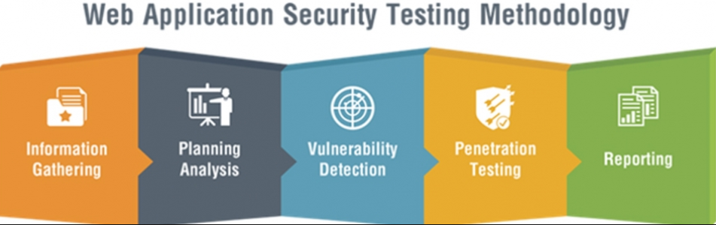
Cont.…
Sample Tools used for Security testing:
Security Assessment
HP Web Inspect
Veracode
Checkmarx
IBM AppScan
Coverity

Slide 7
Input Validation
Input validation is performed to ensure only properly formed data is entering the workflow in an information system, preventing malformed data from persisting in the database and triggering malfunction of various downstream components. Input validation should happen as early as possible in the data flow, preferably as soon as the data is received from the external party.
Data from all potentially untrusted sources should be subject to input validation, including not only Internet-facing web clients but also backend feeds over extranets, from suppliers, partners, vendors or regulators, each of which may be compromised on their own and start sending malformed data.
Input Validation should not be used as the primary method of preventing XSS, SQL Injection and other attacks which are covered in respective cheat sheets but can significantly contribute to reducing their impact if implemented properly.

Slide 8
Cross site scripting vulnerability ( XSS )
Cross-site Scripting (XSS) refers to client-side code injection attack wherein an attacker can execute malicious scripts into a legitimate website or web application. An attacker can use XSS to send a malicious script to an unsuspecting user. The malicious script can access any cookies, session tokens, or other sensitive information retained by the browser and used with that site.
Occurs when:
Data enters web application from untrusted source.
Data is included in dynamic content that is sent to a web user without being validated for malicious code.
Consequences:
Disclosure of user session cookie
Allowing hacker to hijack users session
Disclosure of end user files
Installation of Trojan horse program

Slide 9
Contd.…
Redirecting user to some other web page
Modifying content of web site
Spread web worms
Control the browser remotely
Denial of service attack
Example for XSS Injection
The following server-side pseudo-code is used to display the most recent comment on a web page.
print "<html>" print “
<h1>Most recent comment</h1>"
print database.latest Comment print "</html>“
The above script is simply printing out the latest comment from a comments database and printing the contents out to an HTML page, assuming that the comment printed out only consists of text.

Slide 10
Contd...
The above page is vulnerable to XSS because an attacker could submit a comment that contains a malicious payload such as
<script>doSomethingEvil();</script>.
Users visiting the web page will get served the following HTML page.
<html> <h1>Most recent comment</h1>
<script>doSomethingEvil();</script>
</html>
When the page loads in the victim’s browser, the attacker’s malicious script will execute, most often without the user realizing or being able to prevent such an attack.
Mitigation
Validate untrusted data using whitelist validation.
HTML escape before inserting untrusted data into HTML element content.
Use HTTPOnly cookie flag.
URL Escape before inserting untrusted data into HTML URL parameter values.

Slide 11
SQL Injection
SQL injection (SQLi) is an application security weakness that allows attackers to control an application’s database – letting them access or delete data, change an application’s data-driven behavior, and do other undesirable things – by tricking the application into sending unexpected SQL commands.
Occurs when
Data enters from untrusted source
Data is used to dynamically construct SQL query
Consequences
Confidentiality : Can result in loss of confidential data stored in database.
Authentication : If poor SQL commands are used to check usernames and passwords, it may be possible to connect a system as another user.
Authorization : may be possible to change authorization information stored in database.
Integrity : just as sensitive data can be read, so also it may be possible to change or delete such information.

Slide 12
contd…
Example for SQL Injection:
Product Search :
This input is put directly into the SQL statement within the Web application:
$query = “SELECT prodinfo FROM prodtable WHERE prodname = ‘” . $_POST[‘prod_search’] . “’”;
Creates the following SQL :
SELECT prodinfo FROM prodtable WHERE prodname =
Attacker has now successfully caused the entire database to be returned.

Slide 13
contd…
Mitigation
Check syntax of input for validity. Email addresses, dates, part numbers, etc. Verify that the input is a valid string in the language. Escape all user supplied input.
Use prepared statements or parameterized stored procedures.
Least privilege – Use the database id with the least privileges, don’t use admin id’s for your application accounts.
Use White list input validation – This can be used to detect unauthorized input before It is passed to the SQL query.
Use Escaping table names – don’t allow the user to specify the table names and don’t use dynamic table names.

Slide 14
Information Leakage or Information Disclosure
It is a vulnerability where the application will reveal sensitive data such as technical details of the web application or the user specific data. Sensitive data may be used by an attacker to exploit the target web application, its hosting network, or its users.
Occurs when
Sensitive data is dumped onto the console , written to a log file or exposed to remote user.
Consequences
Confidentiality : Can result in loss of confidential data stored in database.
An attacker can obtain information such as Exact OS and its version, Internal IP addresses, Server environment variables etc.

Slide 15
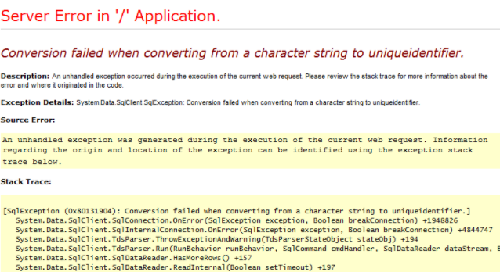

contd…
Examples for information disclosure
For example Script Error messages,
In the above example the input should be numeric, but non numeric characters has been given as input. Now, the following is possible:
The attacker will be able to target the parameter
Since the line number where the error occurred is known, he will be able to confirm whether two different requests are triggering the same error or different errors.
It is easy to determine the sequence in which different parameters are processed.
And finally will be able to map out the different code paths being executed on the server.

Slide 16
contd…
Mitigation
Store Sensitive Information in session variables. Do not use request parameters (GET/Post) for this.
Transmit such information using secured channels like HTTPS.
Do not store sensitive information on client side by using cookies, hidden fields etc. Use server side session variable or the database for this.
Data sent to user must be revalidated on server side once the last page is submitted, even though it was validated earlier.
Make sure no sensitive user data is revealed in the error messages.

Slide 17
Broken Authentication and Session Management
Anonymous external attackers as well as users with their own accounts, who may attempt to steal accounts from others. Attacker uses leaks or flaws in the authentication or session management functions (e.g. exposed accounts, passwords, session IDs) to impersonate users.
Developers frequently build custom authentication and session management schemes, but building these correctly is hard. As a result, these custom schemes frequently have flaws in areas such as logout, password management, timeouts, remember me, secret question, account update, etc.
Occurs when:
User authentication credentials are not protected when stored.
Predictable login credentials.
Session IDs are exposed in the URL (e.g., URL rewriting).
Session IDs are vulnerable to session fixation attacks.
Session value does not timeout or does not get invalidated after logout.
Session IDs are not rotated after successful login.

Slide 18
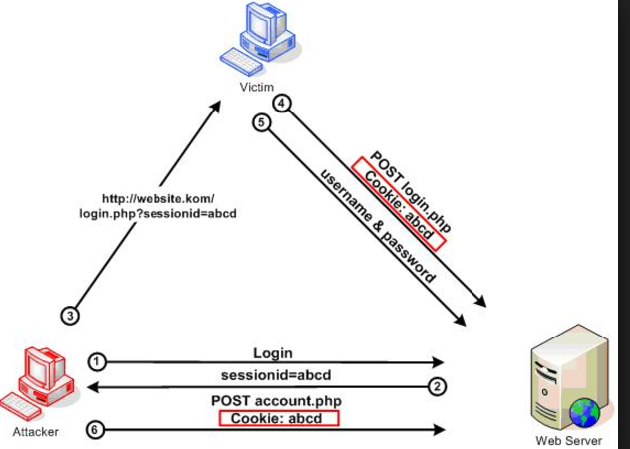
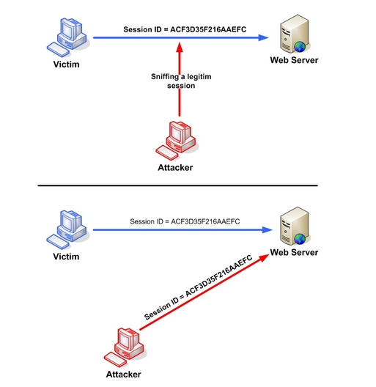
contd…
Passwords, session IDs, and other credentials are sent over unencrypted connections.
Consequences:
The goal of an attack is to take over one or more accounts and for the attacker to get the same privileges as the attacked user.
Confidentiality : Can result in data breach and accessing confidential information of valid users .
Session Fixation Session Hijacking

Slide 19
contd…
Mitigation:
Session Management | Broken Authentication
Credentials should be protected: User authentication credentials should be protected when stored using hashing or encryption. | Password length: Minimum password length should be at least eight (8) characters long. Combining this length with complexity makes a password difficult to guess using a brute force attack.
Do not expose session ID in the URL: Session IDs should not be exposed in the URL (e.g., URL rewriting). | Password complexity: Passwords should be a combination of alphanumeric characters. Alphanumeric characters consist of letters, numbers, punctuation marks, mathematical and other conventional symbols.
Session IDs should timeout: User sessions or authentication tokens should be properly invalidated during logout. | Username/Password Enumeration: Authentication failure responses should not indicate which part of the authentication data was incorrect. For example, instead of "Invalid username" or "Invalid password", just use "Invalid username and/or password" for both.
Recreate session IDs: Session IDs should be recreated after successful login. | Protection against brute force login: Enforce account disabling after an established number of invalid login attempts (e.g., 3 attempts is common).
Do not send credentials over unencrypted connections: Passwords, session IDs, and other credentials should not be sent over unencrypted connections. | Limit or increasingly delay failed login attempts. Log all failures and alert administrators when credential stuffing, brute force, or other attacks are detected.

Slide 20
Security Misconfiguration
Improper server or web application configuration leading to various flaws:
Debugging enabled.
Incorrect folder permissions.
Using default accounts or passwords.
Setup/Configuration pages enabled.
All of your data could be stolen or modified slowly over time.
Application security architectures do not follow security by default. On the contrary, programmers must apply security measures to avoid access to private or confidential resources.
Mitigation
The principle of least privilege: Everything off by default.
Disable administration interfaces.
Disable debugging.
Disable use of default accounts/passwords.
Configure server to prevent unauthorized access, directory listing, etc.
Consider running scans and doing audits periodically to help detect future misconfigurations or missing patches.

Slide 21
Cross Site Request Forgery
Cross-site Request Forgery (CSRF), XSRF, or Sea surf refers to an attack against authenticated web applications using Cookies wherein an attacker is able to trick a victim into making a request the victim did not intend to make.
During a Cross-site Request Forgery (CSRF) attack, the victim’s browser is tricked into sending HTTP requests to the web application as intended by the attacker, normally, such a request would involve submitting forms present on the web application to alter some data.
The following is a simple example of how CSRF can be abused using POST requests through the use of an <iframe> tag. This code would be loaded in an iframe which is made invisible to the victim.
<iframe src="http://attacker.com/csrfAttack" style="width:0;height:0;border:0;border:none;"></iframe>
<body onload="document.getElementById('csrf').submit()">
<form id="csrf" action="http://example.com/changePassword.php" method="POST">
<input name="newPassword" value="attackerPassword" />
</form>
</body>

Slide 22
Cont..
Mitigation :
The recommended and the most widely used prevention technique for preventing Cross-site Request Forgery (CSRF) attacks is known as an anti-CSRF token, also sometimes referred to as synchronizer tokens.
When a user submits a form or makes some other authenticated request that requires a Cookie, the anti-CSRF token should be included in the request.
The anti-CSRF token should be unique for each user session.
The anti-CSRF token should be cryptographically secure, that is, generated by a strong Pseudo-Random Number Generator (PRNG) algorithm

Slide 23
Components With Known Vulnerabilities
Some vulnerable components (e.g., framework libraries) can be identified and exploited with automated tools, expanding the threat agent pool beyond targeted attackers to include chaotic actors.
Virtually every application has these issues because most development teams don't focus on ensuring their components/libraries are up to date.
In many cases, the developers don't even know all the components they are using, never mind their versions. Component dependencies make things even worse.
Mitigation:
Most component projects do not create vulnerability patches for old versions. Instead, most simply fix the problem in the next version. So upgrading to these new versions is critical.
Identify all components and the version that are being used the project and monitor the security issues and keep them up-to-date.

Slide 24
Broken Access Control
Access control enforces policy such that users cannot act outside of their intended permissions.
Failures typically lead to unauthorized information disclosure, modification or destruction of all data, or performing a business function outside of the limits of the user.
Common access control vulnerabilities include :
Bypassing access control checks by modifying the URL, internal application state, or the HTML page, or simply using a custom API attack tool.
Allowing the primary key to be changed to another's users record, permitting viewing or editing someone else's account.
Elevation of privilege. Acting as a user without being logged in, or acting as an admin when logged in as a user.
Metadata manipulation, such as replaying or tampering with a JSON Web Token (JWT) access control token or a cookie or hidden field manipulated to elevate privileges, or abusing JWT invalidation
Force browsing to authenticated pages as an unauthenticated user or to privileged pages as a standard user. Accessing API with missing access controls for POST, PUT and DELETE.

Slide 25
Contd.
Example :
An attacker simply modifies the acct parameter in the browser to send whatever account number they want. If not properly verified, the attacker can access any user's account.
http://example.com/app/accountInfo?acct=notmyacct
An attacker simply force browses to target URLs:
http://example.com/app/getappInfo
http://example.com/app/admin_getappInfo
If an unauthenticated user can access either page, it’s a flaw. If a non-admin can access the admin page, this is a flaw.

Slide 26
Contd.
Mitigation:
Access control is only effective if enforced in trusted server-side code or server-less API, where the attacker cannot modify the access control check or metadata.
Deny access to functionality by default.
Use Access control lists and role-based authentication mechanisms.
Do not just hide functions.

Slide 27
Hardening the HTTP Response headers
Content Security Policy:
The CSP header allows you to define a whitelist of approved sources of content for your site. By restricting the assets that a browser can load for your site, like js and CSS, CSP can act as an effective countermeasure to XSS attacks.
A CSP header allows you to define approved sources for content on your site that the browser can load. By specifying only those sources that you wish the browser to load content from, you can protect your visitors from a whole range of issues. Here is a basic CSP response header.
“ Content-Security-Policy: script-src 'self’ “
HTTP Strict Transport Security:
Sites have always heavily relied on a 301/302 redirect to take users from browsing over HTTP to HTTPS. With browsers defaulting to HTTP when you type in an address like scotthelme.co.uk, this has previously been the only way. HSTS allows you to tell a browser that you always want a user to connect using HTTPS instead of HTTP. This means any bookmarks, links or addresses the user types will be forced to use HTTPS, even if they specify HTTP.
Ex : In NginX configuration : add_header Strict-Transport-Security "max-age=31536000; includeSubdomains" always;

Slide 28
Contd..
X-Frame-Options:
The X-Frame-Options header (RFC), or XFO header, protects your visitors against clickjacking attacks.
An attacker can load up an iframe on their site and set your site as the source, it's quite easy: <iframe src="https://scotthelme.co.uk"></iframe>. Using some crafty CSS they can hide your site in the background and create some genuine looking overlays.
When your visitors click on what they think is a harmless link, they're actually clicking on links on your website in the background. That might not seem so bad until we realize that the browser will execute those requests in the context of the user, which could include them being logged in and authenticated to your site!.
Valid values include DENY meaning your site can't be framed, SAMEORIGIN which allows you to frame your own site or ALLOW-FROM https://example.com/ which lets you specify sites that are permitted to frame your own site.
Ex: In NginX web config : add_header X-Frame-Options "SAMEORIGIN" always;

Slide 29
Contd..
X-Content-Type-Options:
This HTTP Response header only has one valid value, “ nosniff “. It prevents Google Chrome and Internet Explorer from trying to mime-sniff the content-type of a response away from the one being declared by the server. It reduces exposure to drive-by downloads and the risks of user uploaded content that, with clever naming, could be treated as a different content-type, like an executable.
Ex : In NginX web config : add_header X-Content-Type-Options "nosniff" always;

Slide 30
References:
https://www.owasp.org/index.php/Main_Page
https://scotthelme.co.uk/hardening-your-http-response-headers/
https://hdivsecurity.com/owasp-top-10
https://www.owasp.org/index.php/Web_Application_Security_Guidance

Slide 31
Thank You !!!

